Slide 1



《离散数学》
Chapter 10：Graphs（I）
王晓黎
2025年12月10日

Slide 2
Outline
Small World Experiment
Graphs and Graph Models
Graph Terminology and Special Types of Graphs
Representing Graphs and Graph Isomorphism (图同构)
Connectivity (连接性)
Euler and Hamiltonian Graphs (欧拉图、哈密顿图)

Slide 3
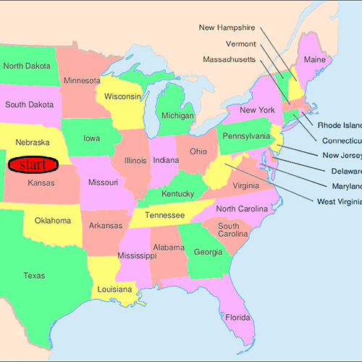
Small World Experiment
296 letters are mailed out for a person in U.S.
64 reached, and the average path length fell around five and a half or six
Notes:
1929年,匈牙利作家F·Karinthy最早提出了“小世界现象”的论断【1】。他认为,地球上的任何两个人都可以平均通过一条由六位联系人组成的链条而联系起来。而后,在20世纪60年代,美国哈佛大学社会心理学教授斯坦利·米尔格兰姆(Stan-ley Milgram)通过设计一个连锁信件实验

Slide 4
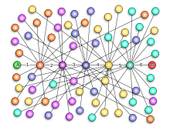
Small-World Phenomenon (小世界理论)
When we look at large social network with thousands of nodes, we find that distances are generally quite short, often less than 10
  This is called the Small-World phenomenon

Slide 5
Problems in the Experiment
Suffers from selection and non-response bias
  Only a small number of letters reached its destination
    64 of 296
    24 of 160
Why?
  People often refuse to pass the letter forward
Notes:
Researchers argue that the results are unconvincing.

Slide 6
How to improve the experiments?
Use a social graph (社交图) to model social relationships between humans

Slide 7
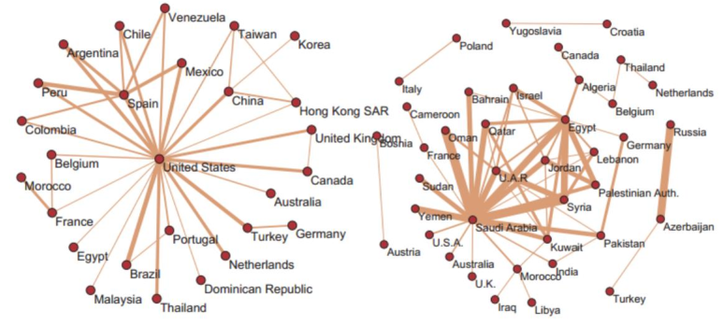
A New Experiment
A large-scale study was done by Leskovec & Horvitz (2008) in Microsoft Instant Messenger network
  Analyzed 240 million active user accounts for a month
https://arxiv.org/abs/0803.0939

Slide 8
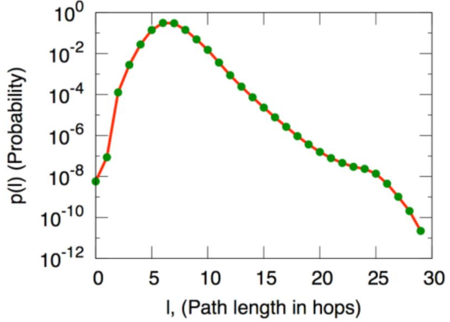
The Results
The small world phenomenon has been replicated in this study
  Estimated Average Distance = 6.6
Why?

Slide 9
Small-World Phenomenon (Continued)
In fact, a distance of 6 can socially scaled to a huge number
  Suppose everyone has on average 100 acquaintances and there is little overlap between acquaintanceships
    Me: 1
    Acquaintances: 100
    Acquaintances at distance 2: 100^2=10,000
    Acquaintances at distance 3: 100^3=1,000,000
    Acquaintances at distance 4: 100^4=100,000,000
    Acquaintances at distance 5: 100^5=10,000,000,000

Slide 10
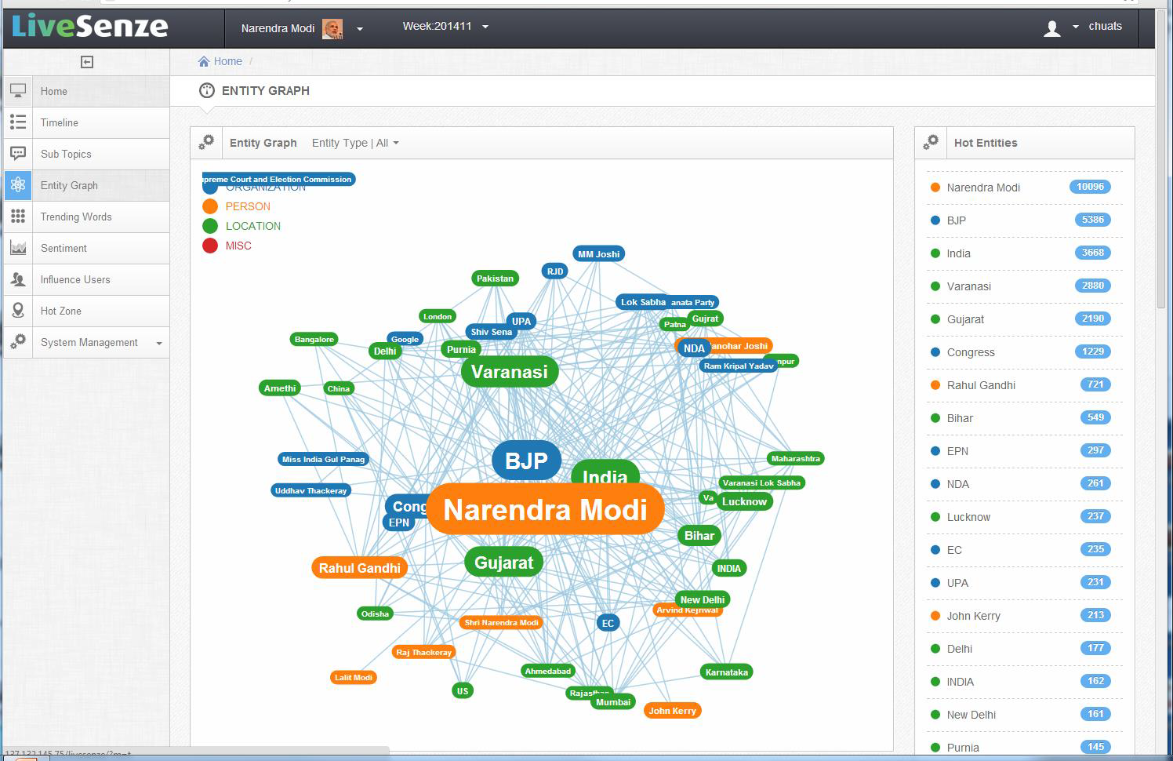
The application of social graph
Build a social graph from social network systems
Tango
Xiaoli Wang
Jiawei Han
Notes:
We randomly pick two people in the social graph (10000 pairs): one is the start person, and the other is the destination person.
Find the shortest path from the start person to the destination person.
The results show that the average path lengths for the social networks of people is about SIX.

Slide 11




The application of social graph (Continued)
Tango
Xiaoli Wang
Jiawei Han

Slide 12
Two questions to be answered：
What is graph?
What is social graph?

Slide 13
Graphs and Graph Models
Introduction to Graphs
Graph Taxonomy
Graph Models

Slide 14
Graphs
Definition
  A graph G = (V, E) consists of a nonempty set V of vertices (or nodes) and a set E of edges
    Each edge has either one or two vertices associated with it, called its endpoints (端点)
    An edge is said to connect its endpoints
Remarks
  A graph with an infinite vertex set is called an infinite graph
  A graph with a finite vertex set is called a finite graph
  We restrict our attention to finite graphs
a
b
Example:
This is a graph with three vertices and three edges
c

Slide 15
Some Terminology
In a simple graph (简单图) each edge connects two different vertices and no two edges connect the same pair of vertices
Multigraphs (多重边) may have multiple edges connecting the same two vertices. When m different edges connect the vertices u and v, we say that {u,v} is an edge of multiplicity m
An edge that connects a vertex to itself is called a loop (环)
A pseudograph (伪图) may include loops, as well as multiple edges connecting the same pair of vertices
Example:
This pseudograph has both multiple edges and a loop
a
b
Remark: There is no standard terminology for graph theory. So, it is crucial that you understand the terminology being used whenever you read material about graphs.
c
Notes:
伪图：数学中允许节点之间有环和多重边的图。本门课程接下去提到的图都指的是简单图。

Slide 16
Directed Graphs
Definition
  An directed graph (or digraph) (有向图) G = (V, E) consists of a nonempty set V of vertices (or nodes) and a set E of directed edges (or arcs) (有向边)
    Each edge is associated with an ordered pair of vertices
    The directed edge associated with the ordered pair (u,v) is said to start at u and end at v
Remarks
  Graphs where the endpoints of an edge are not ordered are said to be undirected graphs (无向图)
a
b
Example:
This is a directed graph with three vertices and four edges
c

Slide 17
Some Terminology (continued)
A simple directed graph has no loops and no multiple edges
A directed multigraph may have multiple directed edges. When there are m directed edges from the vertex u to the vertex v, we say that (u,v) is an edge of multiplicity m
Example:
a
b
This is a directed graph with three vertices and four edges
c
Example:
In this directed multigraph the multiplicity of (a,b) is 1 and the multiplicity of (b,c) is 2
a
b
c

Slide 18
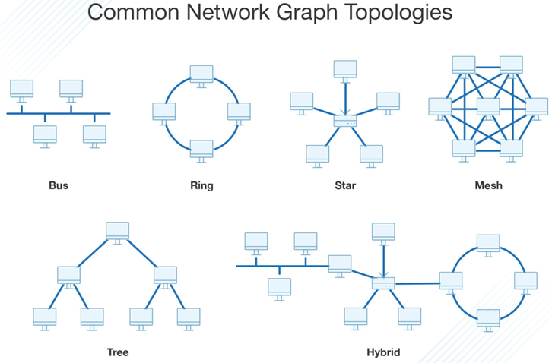
Graph Models: Computer Networks
When we build a graph model, we use the appropriate type of graph to capture the important features of the application
We illustrate this process using graph models of different types of computer networks
  In all these graph models, the vertices represent data centers and the edges represent communication links
https://www.dnsstuff.com/network-graphs

Slide 19
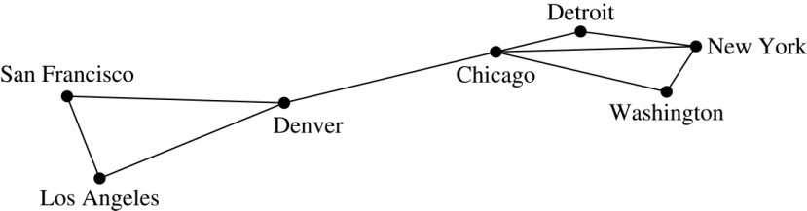
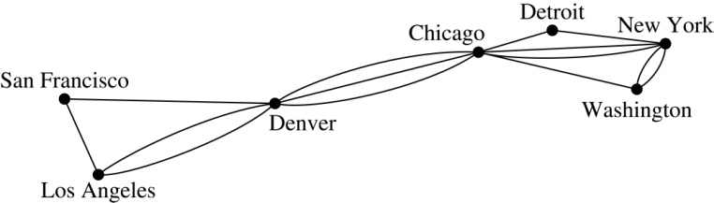
Graph Models: Computer Networks
To model a computer network where we are only concerned whether two data centers are connected by a communications link, we use a simple graph
To model a computer network where we care about the number of links between data centers, we use a multigraph
Notes:
This is the appropriate type of graph when we only care whether two data centers are directly linked and all communications links work in both directions

Slide 20
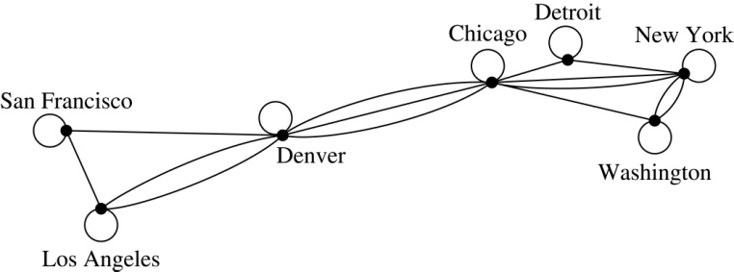
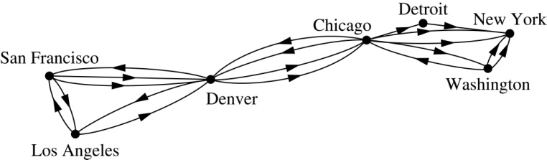
Graph Models: Computer Networks (continued)
To model a computer network with diagnostic links at data centers, we use a pseudograph, as loops are needed
To model a network with multiple one-way links, we use a directed multigraph
  Note that we could use a directed graph without multiple edges if we only care whether there is at least one link from a data center to another data center

Slide 21
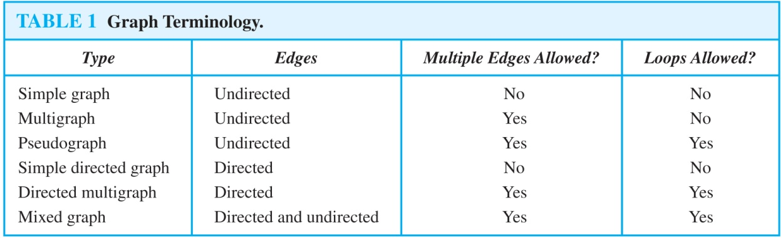
Graph Terminology: Summary
To understand the structure of a graph and to build a graph model, we ask these questions:
  Are the edges of the graph undirected or directed (or both)?
  If the edges are undirected, are multiple edges present that connect the same pair of vertices? If the edges are directed, are multiple directed edges present?
  Are loops present?

Slide 22
Other Applications of Graphs
We will illustrate how graph theory can be used in models of:
  Social networks
  Communications networks
  Information networks
  Software design
  Transportation networks
  Biological networks
It’s a challenge to find a subject to which graph theory has not yet been applied. Can you find an area without applications of graph theory?

Slide 23
Graph Models: Social Networks
Graphs can be used to model social structures based on different kinds of relationships between people or groups
In a social network, vertices represent individuals or organizations and edges represent relationships between them
Useful graph models of social networks include:
  friendship graphs - undirected graphs where two people are connected if they are friends (in the real world, on Facebook, or in a particular virtual world, and so on.)
  collaboration graphs - undirected graphs where two people are connected if they collaborate in a specific way
  influence graphs - directed graphs where there is an edge from one person to another if the first person can influence the second person

Slide 24
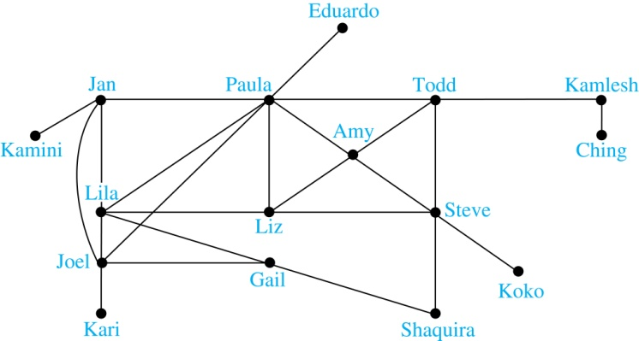
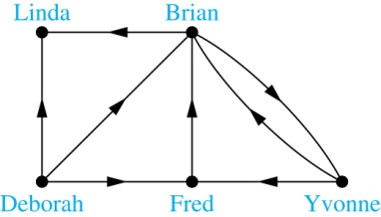
Graph Models: Social Networks (continued)
Example: A friendship graph where two people are connected if they are Facebook friends
Example: An influence graph

Slide 25
Examples of Collaboration Graphs
The Hollywood graph models the collaboration of actors in films
  We represent actors by vertices and we connect two vertices if the actors they represent have appeared in the same movie
An academic collaboration graph models the collaboration of researchers who have jointly written a paper in a particular subject
  We represent researchers in a particular academic discipline using vertices
  We connect the vertices representing two researchers in this discipline if they are coauthors of a paper

Slide 26
Applications to Information Networks
Graphs can be used to model different types of networks that link different types of information
In a web graph, web pages are represented by vertices and links are represented by directed edges
  A web graph models the web at a particular time
In a citation network:
  Research papers in a particular discipline are represented by vertices
  When a paper cites a second paper as a reference, there is an edge from the vertex representing this paper to the vertex representing the second paper

Slide 27
Transportation Graphs
Graph models are extensively used in the study of transportation networks
Airline networks can be modeled using directed multigraphs where
  airports are represented by vertices
  each flight is represented by a directed edge from the vertex representing the departure airport to the vertex representing the destination airport
Road networks can be modeled using graphs where
  vertices represent intersections and edges represent roads
  undirected edges represent two-way roads and directed edges represent one-way roads

Slide 28
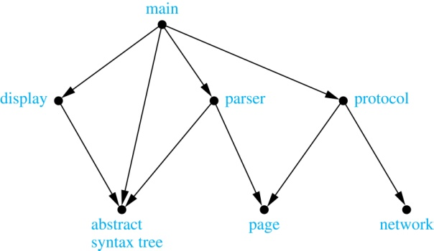
Software Design Applications
Graph models are extensively used in software design. We will introduce two such models here; one representing the dependency between the modules of a software application and the other representing restrictions in the execution of statements in computer programs
When a top-down approach is used to design software, the system is divided into modules, each performing a specific task
We use a module dependency graph to represent the dependency between these modules. These dependencies need to be understood before coding can be done
  In a module dependency graph vertices represent software modules and there is an edge from one module to another if the second module depends on the first
Example: The dependencies between the seven modules in the design of a web browser are represented by this module dependency graph

Slide 29
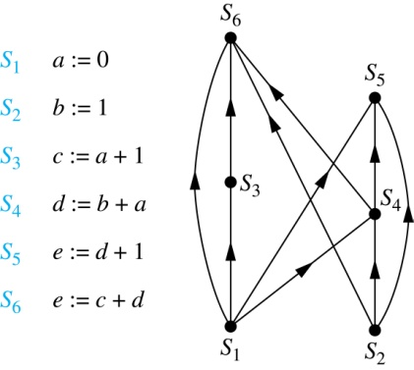
Software Design Applications (continued)
We can use a directed graph called a precedence graph to represent which statements must have already been executed before we execute each statement
  Vertices represent statements in a computer program
  There is a directed edge from a vertex to a second vertex if the second vertex cannot be executed before the first
Example: This precedence graph shows which statements must already have been executed before we can execute each of the six statements in the program

Slide 30
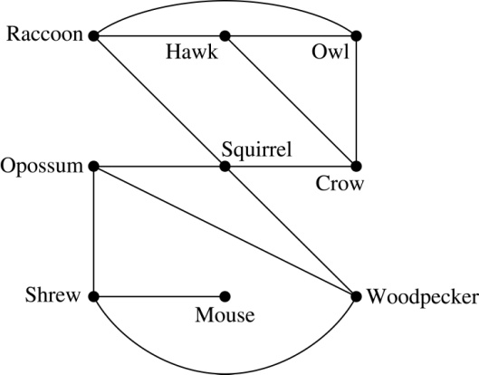
Biological Applications
Graph models are used extensively in many areas of the biological science. We will describe two such models, one to ecology and the other to molecular biology
Niche overlap graphs model competition between species in an ecosystem
  Vertices represent species and an edge connects two vertices when they represent species who compete for food resources
Example: This is the niche overlap graph for a forest ecosystem with nine species

Slide 31
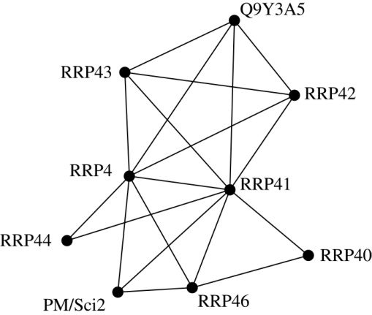
Biological Applications (continued)
We can model the interaction of proteins in a cell using a protein interaction network
In a protein interaction graph, vertices represent proteins and vertices are connected by an edge if the proteins they represent interact
Protein interaction graphs can be huge and can contain more than 100,000 vertices, each representing a different protein, and more than 1,000,000 edges, each representing an interaction between proteins
Protein interaction graphs are often split into smaller graphs, called modules, which represent the interactions between proteins involved in a particular function
Example: This is a module of the protein interaction graph of proteins that degrade RNA in a human cell

Slide 32
Graph Terminology and Special Types of Graphs
Basic Terminology
Some Special Types of Graphs
Bipartite Graphs
Bipartite Graphs and Matchings
Some Applications of Special Types of Graphs
New Graphs from Old

Slide 33

Basic Terminology
Definition 1. Two vertices u, v in an undirected graph G are called adjacent (or neighbors) in G if there is an edge e between u and v. Such an edge e is called incident with the vertices u and v and e is said to connect u and v
Definition 2. The set of all neighbors of a vertex v of G = (V, E), denoted by N(v), is called the neighborhood of v. If A is a subset of V, we denote by N(A) the set of all vertices in G that are adjacent to at least one vertex in A So,
Definition 3. The degree of a vertex in a undirected graph is the number of edges incident with it, except that a loop at a vertex contributes two to the degree of that vertex. The degree of the vertex v is denoted by deg(v)

Slide 34
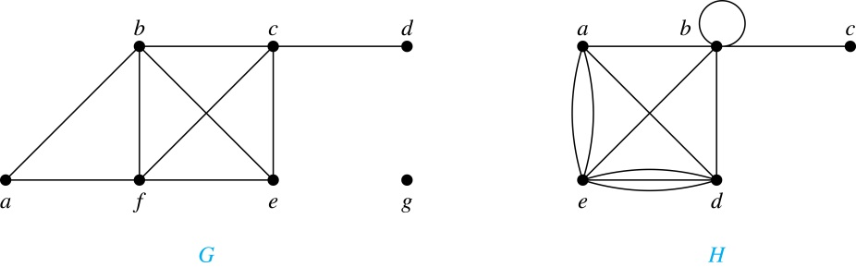
Degrees and Neighborhoods of Vertices
Example: What are the degrees and neighborhoods of the vertices in the graphs G and H?
Solution:
G: deg(a) = 2, deg(b) = deg(c) = deg(f ) = 4, deg(d ) = 1,
deg(e) = 3, deg(g) = 0.
N(a) = {b, f }, N(b) = {a, c, e, f }, N(c) = {b, d, e, f }, N(d) = {c},
N(e) = {b, c , f }, N(f) = {a, b, c, e}, N(g) = ∅ .
H: deg(a) = 4, deg(b) = deg(e) = 6, deg(c) = 1, deg(d) = 5.
N(a) = {b, d, e}, N(b) = {a, b, c, d, e}, N(c) = {b},
N(d) = {a, b, e}, N(e) = {a, b ,d}.

Slide 35
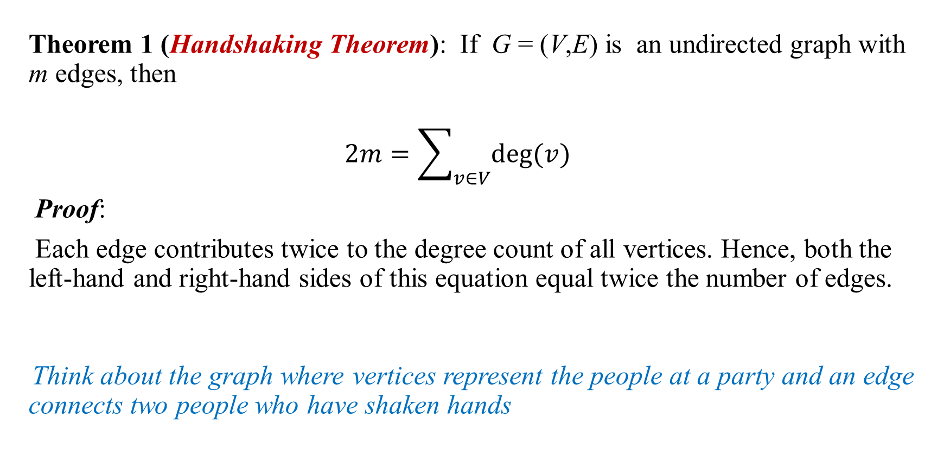
Degrees of Vertices
Theorem 1 (Handshaking Theorem): If G = (V,E) is an undirected graph with m edges, then
$$2m=\sum_{v∈V}{deg⁡(v)}$$
Proof:
Each edge contributes twice to the degree count of all vertices. Hence, both the left-hand and right-hand sides of this equation equal twice the number of edges.
Think about the graph where vertices represent the people at a party and an edge connects two people who have shaken hands

Slide 36
Handshaking Theorem
We now give two examples illustrating the usefulness of the handshaking theorem
Example: How many edges are there in a graph with 10 vertices of degree six?
Solution: Because the sum of the degrees of the vertices is 6 ⋅ 10 = 60, the handshaking theorem tells us that 2m = 60. So the number of edges m = 30.
Example: If a graph has 5 vertices, can each vertex have degree 3?
Solution: This is not possible by the handshaking thorem, because the sum of the degrees of the vertices 3 ⋅ 5 = 15 is odd.

Slide 37
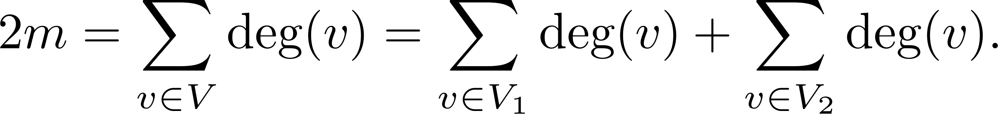
Degree of Vertices (continued)
Theorem 2: An undirected graph has an even number of vertices of odd degree
Proof: Let V₁ be the vertices of even degree and V₂ be the vertices of odd degree in an undirected graph G = (V, E) with m edges. Then
even
This sum must be even because 2m is even and the sum of the degrees of the vertices of even degrees is also even. Because this is the sum of the degrees of all vertices of odd degree in the graph, there must be an even number of such vertices.
must be even since deg(v) is even for each v ∈ V₁

Slide 38
Directed Graphs
Recall the definition of a directed graph.
Definition: An directed graph G = (V, E) consists of V, a nonempty set of vertices (or nodes), and E, a set of directed edges or arcs. Each edge is an ordered pair of vertices. The directed edge (u,v) is said to start at u and end at v
Definition: Let (u,v) be an edge in G. Then u is the initial vertex of this edge and is adjacent to v and v is the terminal (or end) vertex of this edge and is adjacent from u. The initial and terminal vertices of a loop are the same

Slide 39
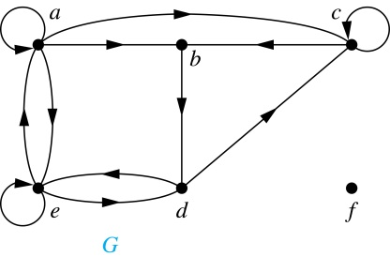
Directed Graphs (continued)
Definition: The in-degree of a vertex v, denoted deg⁻(v), is the number of edges which terminate at v. The out-degree of v, denoted deg⁺(v), is the number of edges with v as their initial vertex. Note that a loop at a vertex contributes 1 to both the in-degree and the out-degree of the vertex
Example: In the graph G we have
deg⁻(a) = 2, deg⁻(b) = 2, deg⁻(c) = 3, deg⁻(d) = 2,
deg⁻(e) = 3, deg⁻(f) = 0.
deg⁺(a) = 4, deg⁺(b) = 1, deg⁺(c) = 2, deg⁺(d) = 2,
deg⁺ (e) = 3, deg⁺(f) = 0.

Slide 40
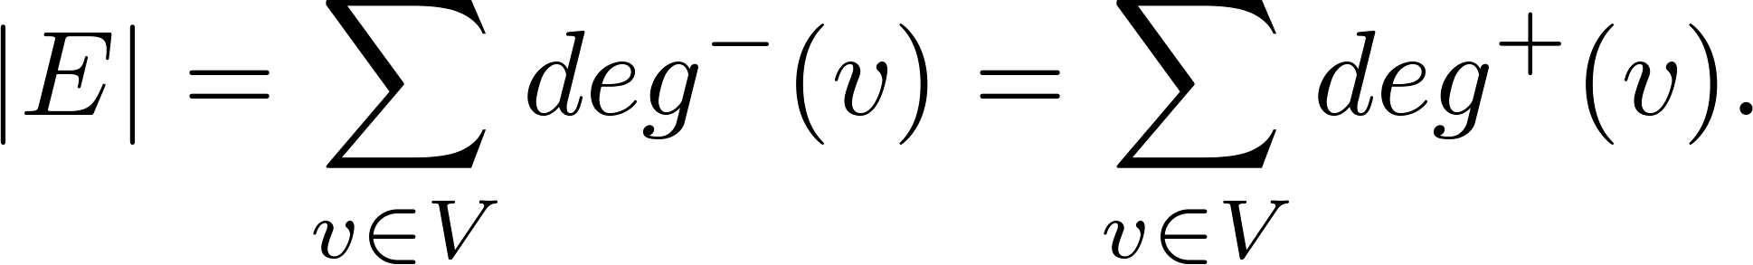
Directed Graphs (continued)
Theorem 3: Let G = (V, E) be a graph with directed edges. Then:
Proof: The first sum counts the number of outgoing edges over all vertices and the second sum counts the number of incoming edges over all vertices. It follows that both sums equal the number of edges in the graph.

Slide 41
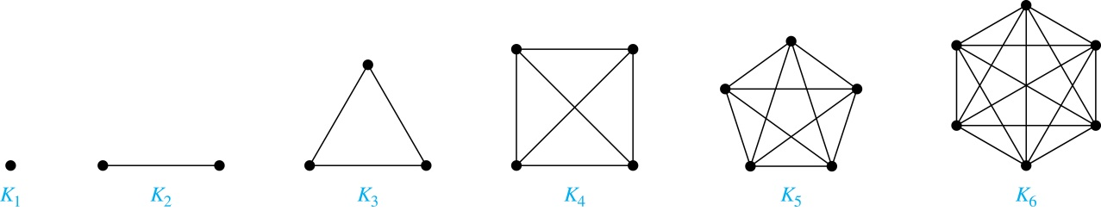
Special Types of Simple Graphs: Complete Graphs
A complete graph on n vertices, denoted by K_{n}, is the simple graph that contains exactly one edge between each pair of distinct vertices

Slide 42
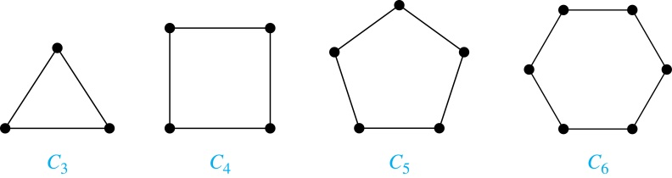
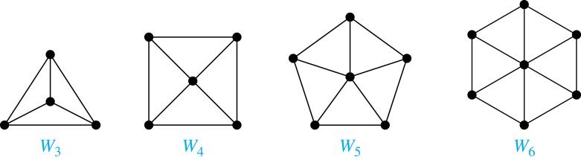
Special Types of Simple Graphs: Cycles and Wheels
A cycle C_{n} for n ≥ 3 consists of n vertices v₁, v₂ ,⋯ , v_{n}, and edges {v₁, v₂}, {v₂, v₃} ,⋯ , {v_{n-1}, v_{n}}, {v_{n}, v₁}
A wheel W_{n} is obtained by adding an additional vertex to a cycle C_{n} for n ≥ 3 and connecting this new vertex to each of the n vertices in C_{n} by new edges

Slide 43
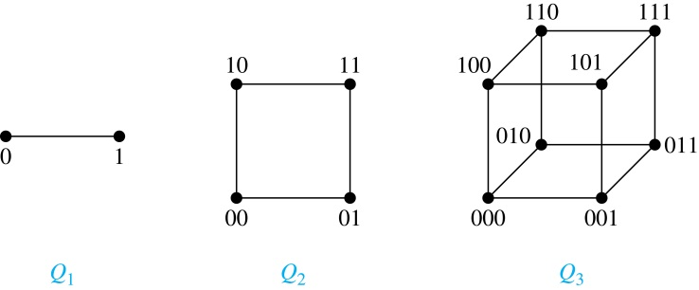
Special Types of Simple Graphs: n-Cubes
An n-dimensional hypercube, or n-cube, Q_{n}, is a graph with 2^{n} vertices representing all bit strings of length n, where there is an edge between two vertices that differ in exactly one bit position

Slide 44
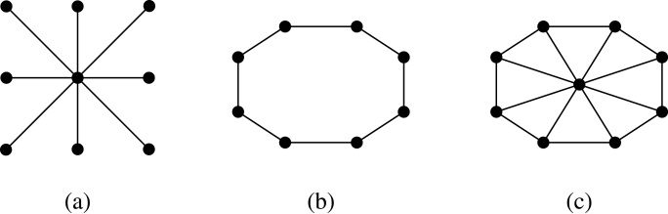
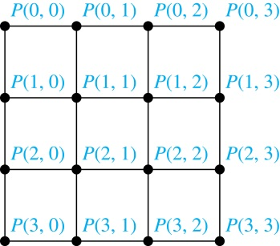
Special Types of Graphs and Computer Network Architecture
Various special graphs play an important role in the design of computer networks.
Some local area networks use a star topology, which is a complete bipartite graph K_{1,n} ,as shown in (a). All devices are connected to a central control device
Other local networks are based on a ring topology, where each device is connected to exactly two others using C_{n} ,as illustrated in (b). Messages may be sent around the ring
Others, as illustrated in (c), use a W_{n}-based topology, combining the features of a star topology and a ring topology
Various special graphs also play a role in parallel processing where processors need to be interconnected as one processor may need the output generated by another
  The n-dimensional hypercube, or n-cube, Q_{n}, is a common way to connect processors in parallel, e.g., Intel Hypercube
  Another common method is the mesh network, illustrated here for 16 processors

Slide 45
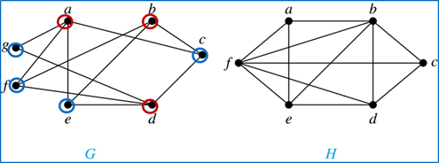
Bipartite Graphs
Definition: A simple graph G is bipartite if V can be partitioned into two disjoint subsets V₁ and V₂ such that every edge connects a vertex in V₁ and a vertex in V₂. In other words, there are no edges which connect two vertices in V₁ or in V₂
It is not hard to show that an equivalent definition of a bipartite graph is a graph where it is possible to color the vertices red or blue so that no two adjacent vertices are the same color
H is not bipartite
since if we color a red, then the adjacent vertices f and b must both be blue.
G is bipartite

Slide 46
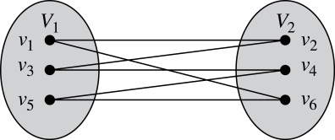
Bipartite Graphs (continued)
Example: Show that C₆ is bipartite.
Solution: We can partition the vertex set into V₁ = {v₁, v₃, v₅} and V₂ = {v₂, v₄, v₆} so that every edge of C₆ connects a vertex in V₁ and V₂ .
Example: Show that C₃ is not bipartite.
Solution: If we divide the vertex set of C₃ into two nonempty sets, one of the two must contain two vertices. But in C₃ every vertex is connected to every other vertex. Therefore, the two vertices in the same partition are connected. Hence, C₃ is not bipartite.

Slide 47
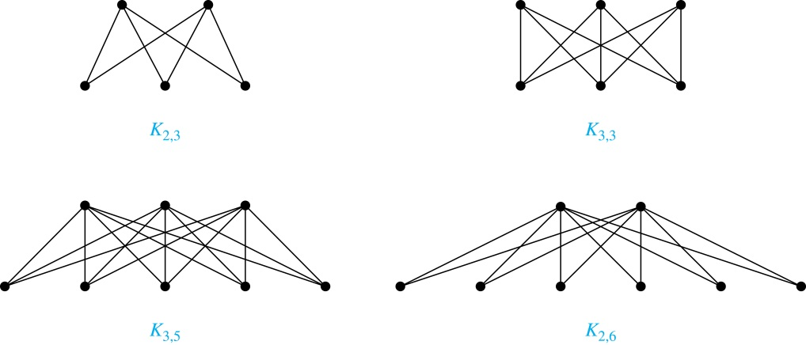
Complete Bipartite Graphs
Definition: A complete bipartite graph K_{m,n} is a graph that has its vertex set partitioned into two subsets V₁ of size m and V₂ of size n such that there is an edge from every vertex in V₁ to every vertex in V₂.
Example: We display four complete bipartite graphs here.

Slide 48
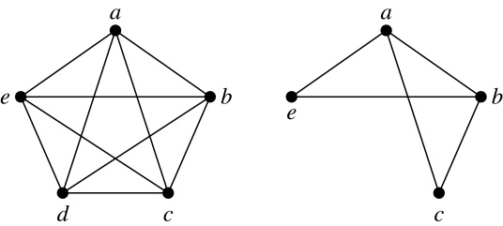
New Graphs from Old
Definition: A subgraph of a graph G = (V,E) is a graph (W,F), where W ⊂ V and F ⊂ E. A subgraph H of G is a proper subgraph of G if H ≠ G.
Example: Here we show K₅ and one of its subgraphs.
Definition: Let G = (V, E) be a simple graph. The subgraph induced by a subset W of the vertex set V is the graph (W,F), where the edge set F contains an edge in E if and only if both endpoints are in W.
Example: Here we show K₅ and the subgraph induced by W = {a,b,c,e}.

Slide 49
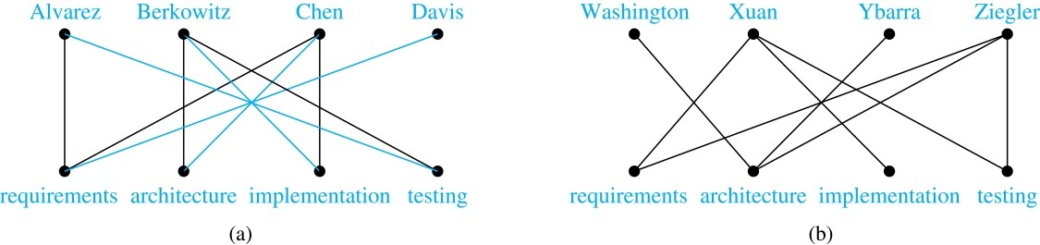
Bipartite Graphs and Matchings
Bipartite graphs are used to model applications that involve matching the elements of one set to elements in another, for example:
Job assignments - vertices represent the jobs and the employees, edges link employees with those jobs they have been trained to do. A common goal is to match jobs to employees so that the most jobs are done
Marriage - vertices represent the men and the women and edges link a a man and a woman if they are an acceptable spouse. We may wish to find the largest number of possible marriages

Slide 50
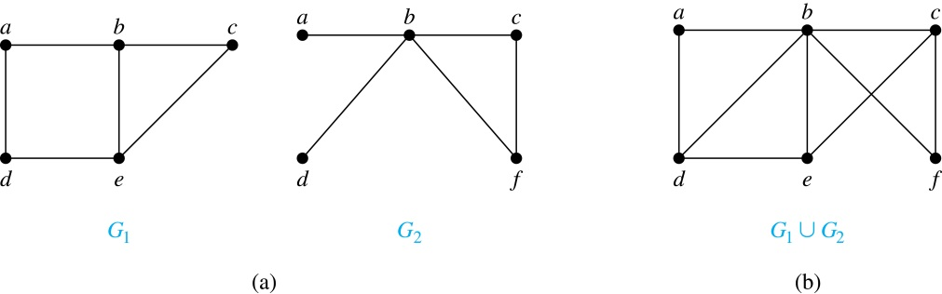
New Graphs from Old (continued)
Definition: The union of two simple graphs G₁ = (V₁, E₁) and G₂ = (V₂, E₂) is the simple graph with vertex set V₁ ⋃ V₂ and edge set E₁ ⋃ E₂. The union of G₁ and G₂ is denoted by G₁ ⋃ G₂.
Example:

Slide 51
Q&A

